Slide 1
Mini Project Report on
INVENTORY MANAGEMENT SYSTEM
Submitted by:
AKSHAT BISHT
2021070
Under the Mentorship of
Dr. Prakash Srivastava
Associate Professor-CSE.

Slide 2
Introduction
The Inventory Management system is a software application that helps business keep track of their inventory levels, sales, orders etc.
Background:-
Inventory management is a critical aspect of business operations, ensuring the efficient tracking and control of goods. The need for an effective inventory management system arises from the challenges posed by manual methods and the growing complexity of business processes.

Slide 3
Problem Statement
The primary objectives of this project include developing a web-based inventory management system that enhances accuracy, reduces human errors, and provides real-time insights into inventory levels. The system aims to streamline operations, optimize resource utilization, and improve overall business efficiency.

Slide 4

Technologies Used
Html
CSS
JavaScript
Node js
Express
Ejs
SQL Database
Packages Required:-
Uuid Nodemon method-override

Slide 5



Methodology
Data flow diagram
User
Frontend(HTML,CSS,JS)
Server
(Express,ejs)
DataBase
(MySQL)

Slide 6



Frontend (HTML, CSS, JavaScript)
HTML is used to design basic structures of the program and helps structure the components. Major HTML components used are :
Buttons
Forms
Table
CSS is responsible for styling the HTML elements, ensuring a visually appealing and consistent presentation across different devices and screen sizes.
Layout and Formatting
Responsiveness
JavaScript is a scripting language that adds interactivity and dynamic behavior to the user interface, enhancing the overall user experience

Slide 7
Server(Express)
Node.js:
Node.js is a server-side JavaScript runtime environment designed to execute JavaScript code outside a web browser. Its key features include:
Non-blocking I/O
Vast Ecosystem (npm)
JavaScript on Both Frontend and Backend
Express:
Express is a minimal and flexible Node.js web application framework that simplifies the process of building robust and scalable web applications. Key aspects of Express include:
Routing
Templating Engine Integration(EJS)
Error Handling(try ,catch ,throw)

Slide 8
Database (MySQL)
MySQL:
MySQL is a popular open-source relational database management system (RDBMS) known for its reliability, scalability, and robust feature set. The choice of MySQL as the database management system for the inventory management system is driven by several factors:
Relational Structure
Data Integrity

Slide 9


Project Snapshots

Slide 10
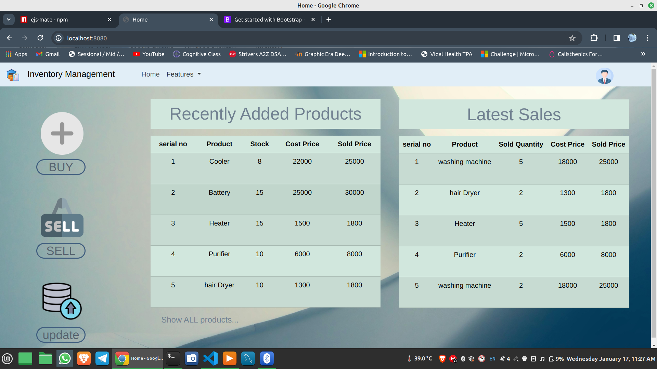
Home page

Slide 11
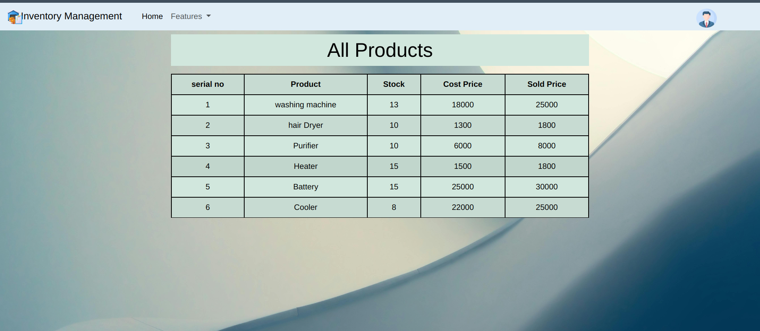
Show page

Slide 12
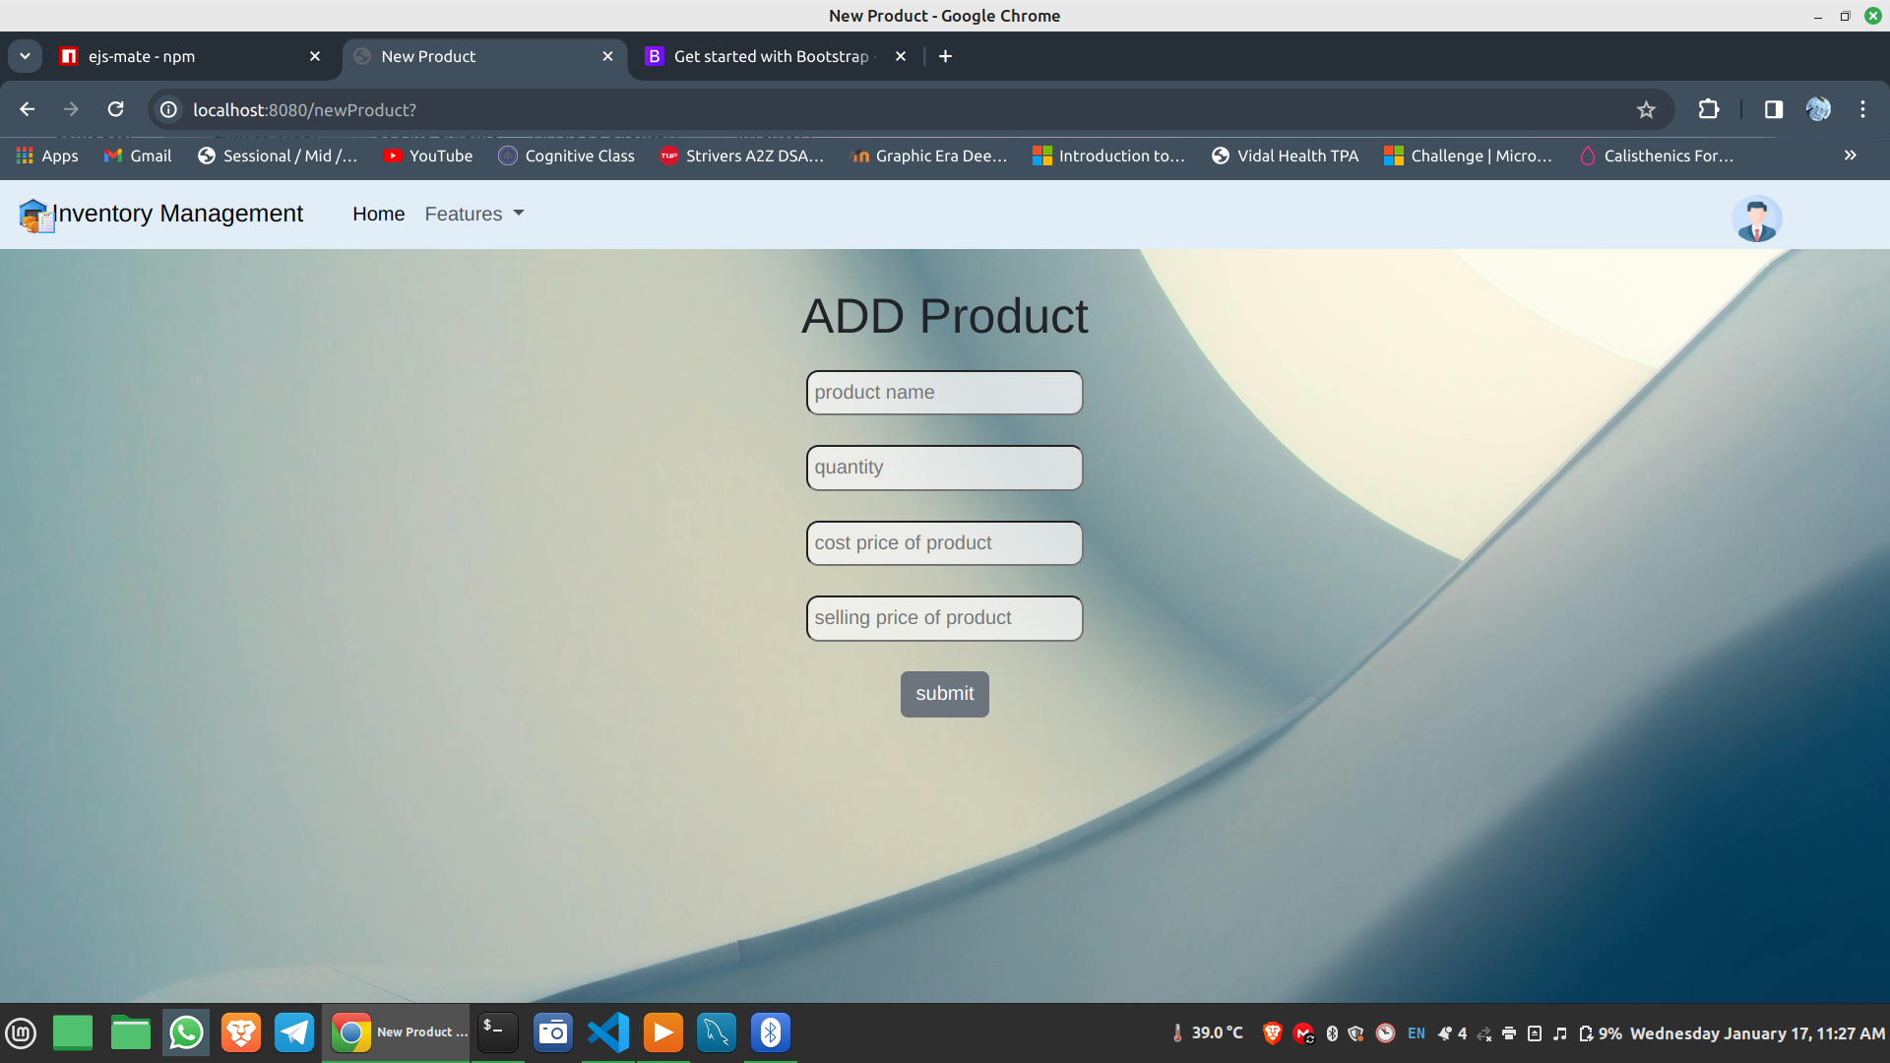
New product page

Slide 13
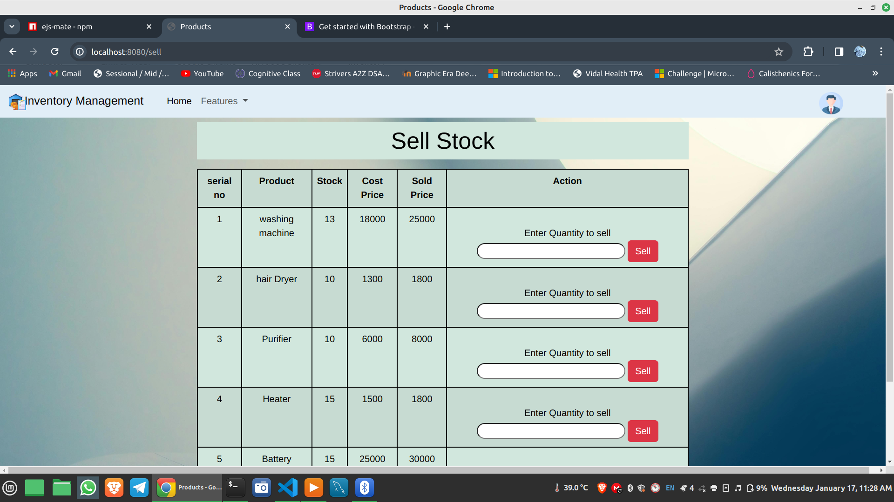
Sell product page

Slide 14
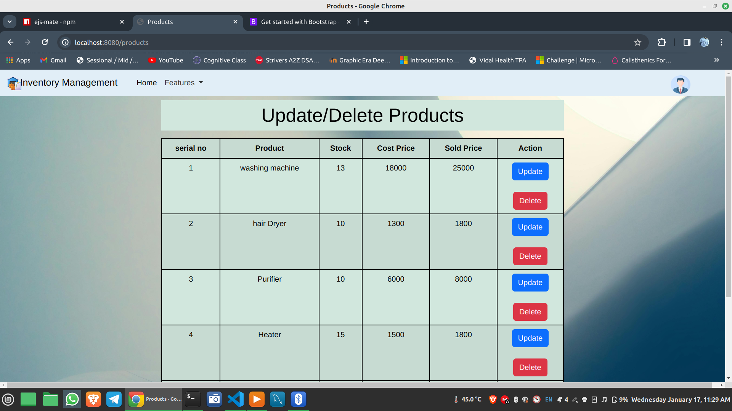
Update product page

Slide 15
Conclusion and Future work
The project aimed to develop an advanced Inventory Management System utilizing web technologies, including HTML, CSS, JavaScript, Node.js, Express, and MySQL. The key findings and contributions of the project are summarized as follows:
Efficient Inventory Tracking:
Reduced Operational Costs:
Enhanced User Experience:

